Slide 1


Make the Grade
Kubilay Kara

Slide 2
About The Problem
A very large and populous state would like a new system to support standardized testing across all public school systems grades 3-12.
Users: 40,000+ students, 2000 graders, 50 administrators.
Requirements:
Students will only be able to use the application within testing centers around the state, most of these will be in the schools, but not all of them
Students should be able to take a test, and the results eventually consolidated to a single location representing all of the test scores across the state (by school, teacher, and student).
Tests will be multiple choice, short answer, and essay.
The system should have a reporting system to know which students have taken the tests and what score they received.
Short answer and essay questions will be manually graded by teachers, who will then add the essay grades to the system.
Additional Context:
A change approval processes involving three different government agencies is required for changes to the way student grades are kept to ensure security.
The state does not own its hosting center, but outsources it to a third party.
Project must defend its budget each fiscal year.

Slide 3
Key Points
Architectural Diagrams (e.g. C4, UML)
API Design
Data Modeling
Security Considerations
Regulatory Considerations
Disaster Recovery / Data Replication

Slide 4
Questions & Assumptions
How can users sign students in?
There is a verified mobile contact number and an email address for each student, grader and administrator. We can send OTP to this number.
What is the maximum number of questions for a test?
Each test can have;
100 multiple choice questions 5 choices for each question
ii. 50 short answer questions, 200 characters for each question
5 essay, 2000 characters for each essay at max.
How many test does a student take per year
Max 10
Do tests have a predetermined date and time?
Yes, tests are done simultaneously for each grade and students can access and submit tests between the start and end times.
Can students take a test afterwards if they have a valid excuse?
No, a test can be valid only once.

Slide 5
Scope
Some possible areas are left out of the scope for sake of simplicity and time constraints.
These ara;
UI Design
Messaging
Exam reminder messages to students
Evaluation reminder messages to teachers

Slide 6
Actors
Administrators
Manages the exam definitions.
Teachers (Graders)
Evaluates text based answers.
Students
Takes exams

Slide 7
Uses Cases: (1) Sign-In
Actor(s)
Administrator, Grader, Student
Basic Flow
User enters her name, phoneNumber and e-mail.
System checks the information with the user records.
Sends an OTP to stored phone number.
User enters the password to the system in 3 minutes.
System asks a permanent password from the user.
User enters new password.
Alternative Flow(s)
2.a User information is not matched with any of the user records.
System pops an information message.
3.a User fails to enter the password
A "resend" button is shown to the user.

Slide 8
Uses Cases: (2) Log-In
Actor(s)
Administrator, Teacher, Student
Basic Flow
User enters e-mail or phone number and password
System checks the information and grands access.
Alternative Flow(s)
2.a Credentials are not valid.
System pops an information message.

Slide 9
Uses Cases: (3) Create Exam Definition
Actor(s)
Administrator
Basic Flow
User selects grade, startTime and endTime
System creates a new exam definition and returns id
User adds questions with questionType, description, order and maxPoints.
User enters every question by repeating step 3
Alternative Flow(s)
2.a User selects a multi choice question
i) User enter a choice with choice detail, order, mark.
User selects an existing mark
System pops an error message
ii) User enters every choice by repeating step (i)
2.b User wants to remove a entered question
System deletes associated question and its choices

Slide 10
Uses Cases: (4) Update Exam Definition
Actor(s)
Administrator
Basic Flow
User enters filter values and clicks a button to list exams.
System returns exam definitions in a list.
User selects an exam definition
User may change startTime, endTime or grade
User may remove or add new questions
User may select a question a changes it's description, order or maxPoint
Alternative Flow(s)
3.a User selects sealed (already completed) exam.
System pops an alert message
6.a User selects a multi value question
User may remove or add new choices
User may select a choice a changes it's detail, order or mark.

Slide 11
Uses Cases: (5) Take an Exam
Actor(s)
Student
Basic Flow
System shows a “start” button for available test for student ( according to grade and date).
User clicks the button
System creates an exam with studentId and exam definitonId.
System creates empty answers for every question.
System returns exemId and questionCount.
User can move back and forth between the questions.
System returns selected answer by answerId
User enters or selects a value and clicks save button
System updates the answer.
Alternative Flow(s)
1.a There is no available test for the student.
An information message is shown.

Slide 12
Uses Cases: (6) Evaluate Answer
Actor(s)
Teacher
Basic Flow
User clicks a button to list answers which can be evaluated by the user. (related students)
System returns a summarised list
User selects an answer form list
System returns related question and current answers by answerId
The teacher gives a score which she deems appropriate
System saves the score for selected answerId
Alternative Flow(s)
2.a User selects an already evaluated answer
System updates answer with the new score

Slide 13
Uses Cases: (7) Auto Evaluate Answers
Actor(s)
-none-
Basic Flow
Scheduler triggers Automatic evaluation process
System collects related exams
System put exams to queue
Evaluator instances works on exams one by one
Alternative Flow(s)
2.a All answers already evaluated
Operation ends.

Slide 14
Uses Cases: (8) Report Results
Actor(s)
Administrator
Basic Flow
User selects enters filter values and clicks a button
System collects the data by date, school, grade, teacher, student and score
System returns the collected data as a table
Alternative Flow(s)

Slide 15
Deliverables/Milestones
Sign-In
Log-In
Take Exam
Text based questions
Multichoice questions
Evaluation
Manual evaluation for text based answers
Automatic evaluation for multichoice answers
Exam Definition
Text based question definitions
Multichoice questions definitions

Slide 16
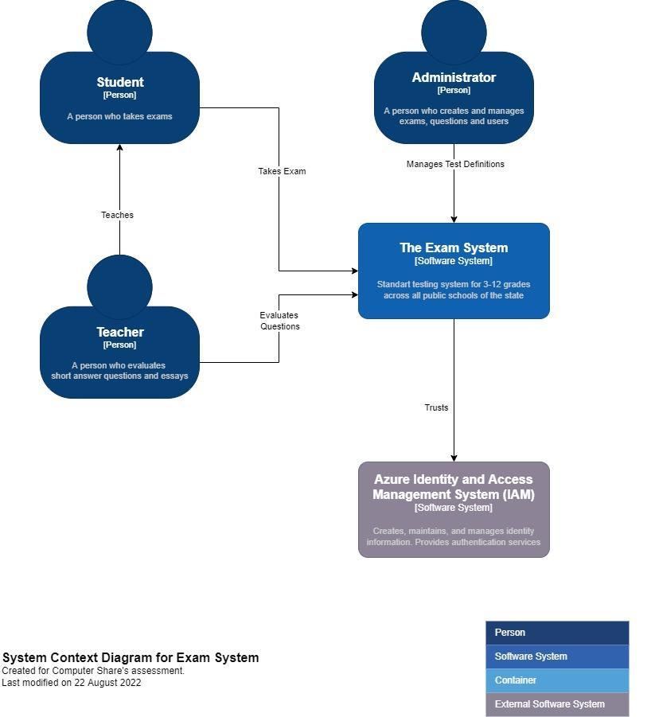
Context Diagram

Slide 17
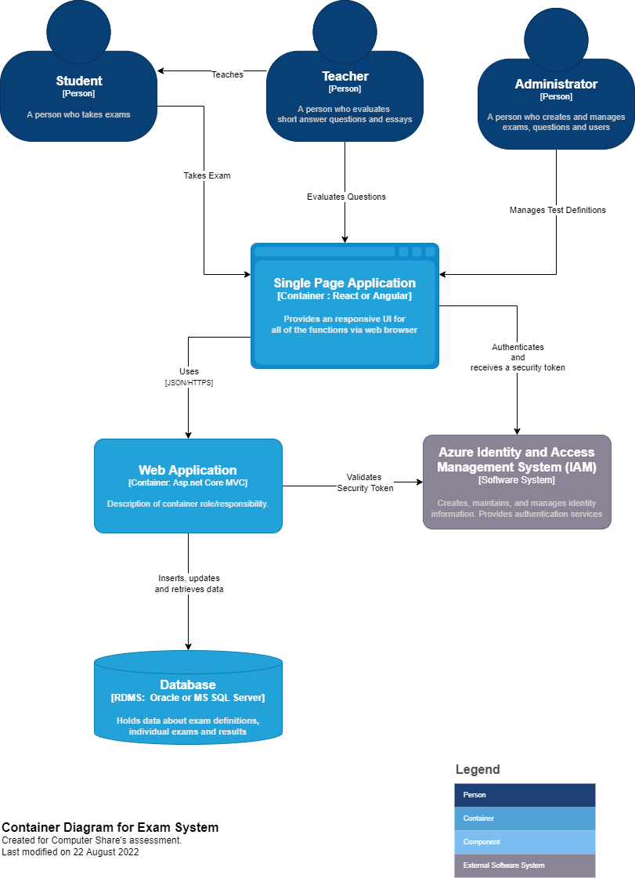
Container Diagram

Slide 18
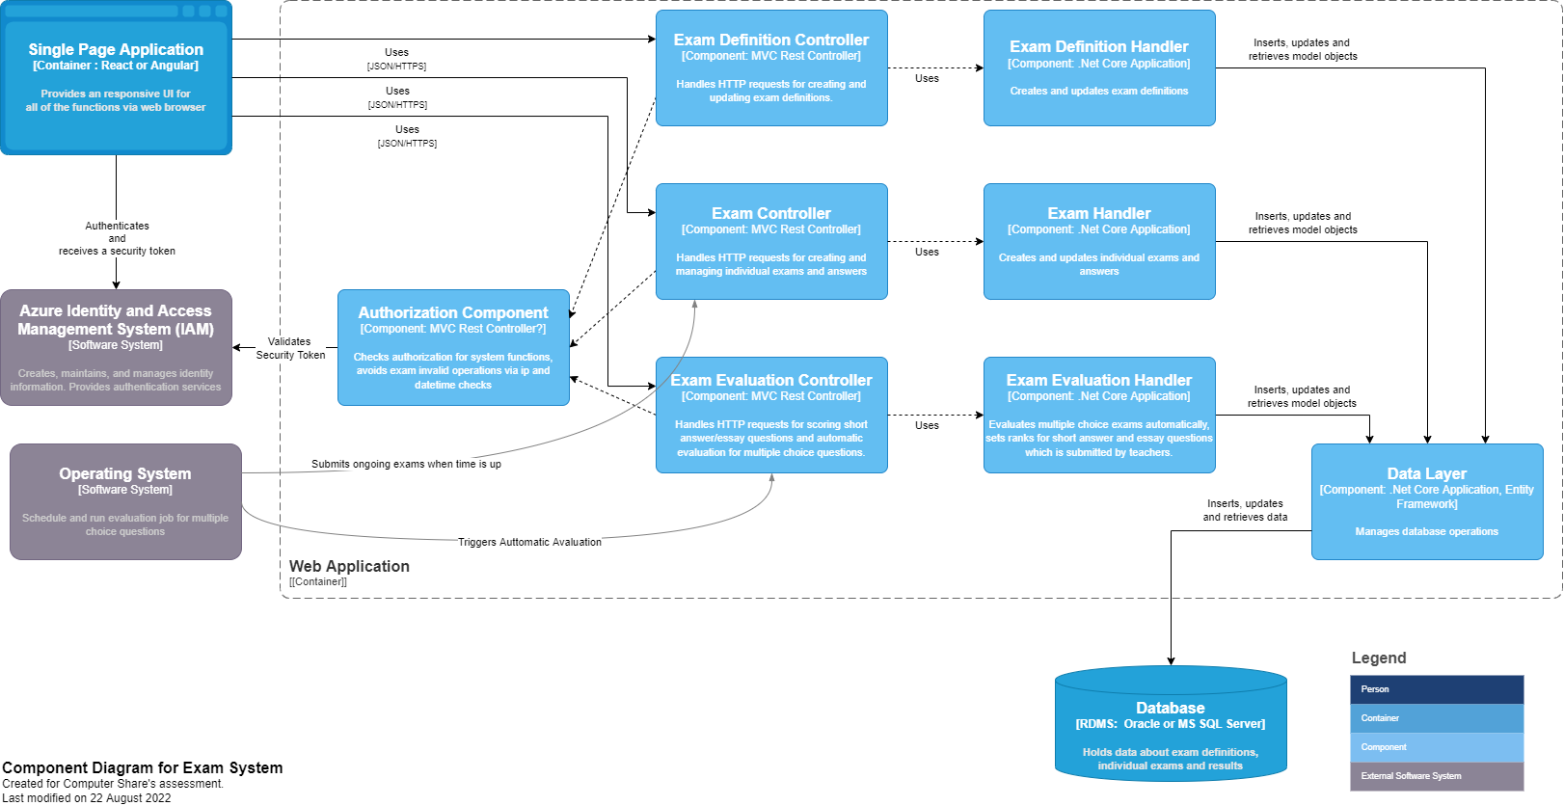
Component Diagram

Slide 19
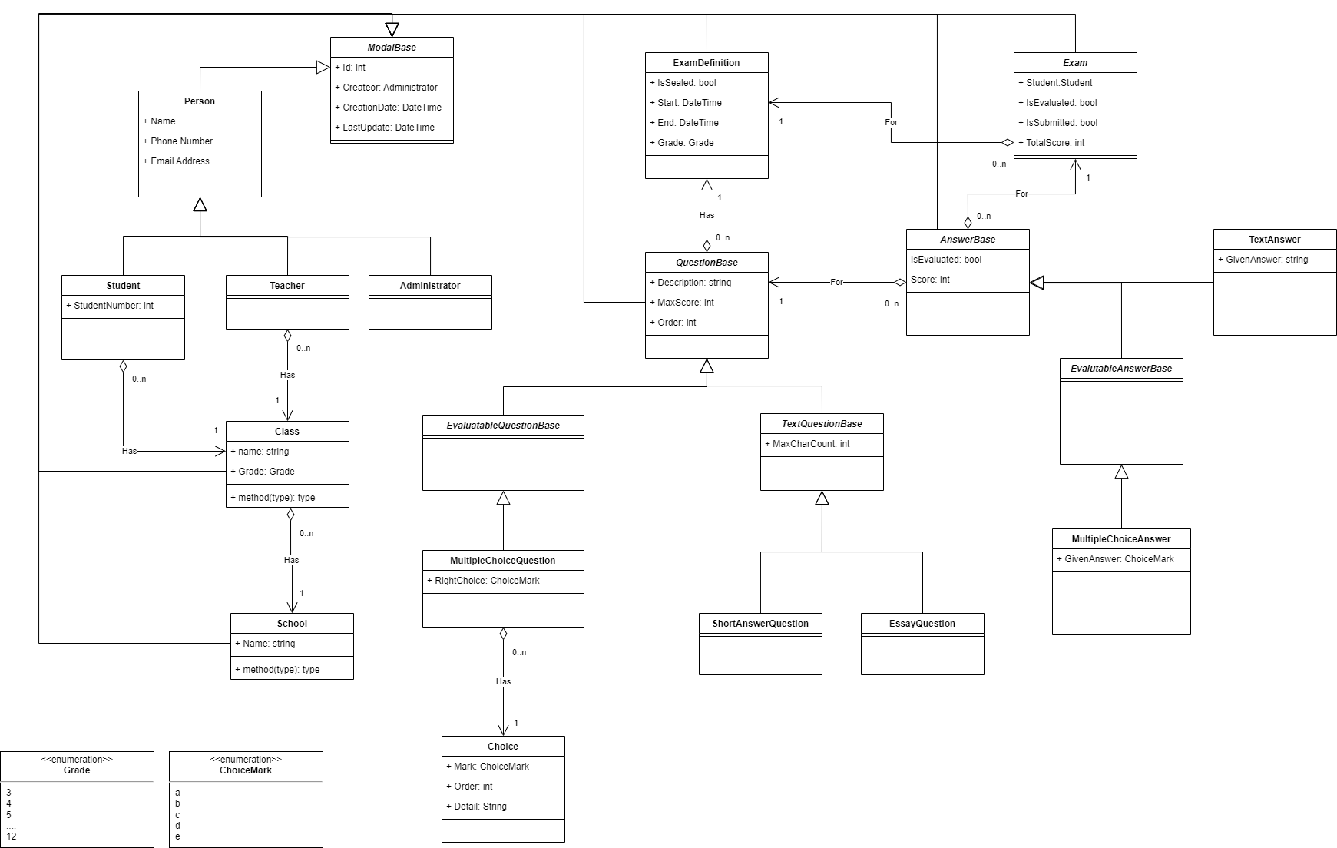
Class Diagram- Data Layer

Slide 20
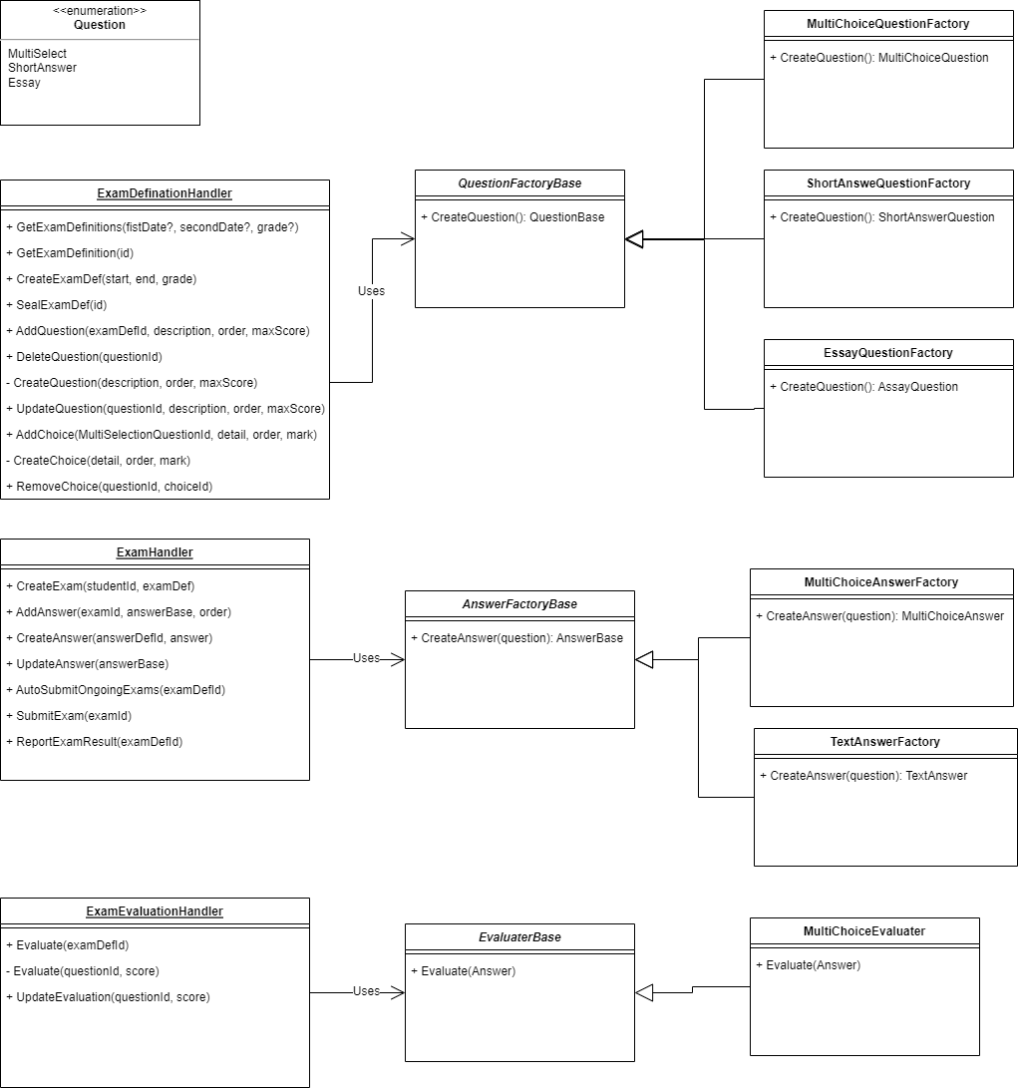
Class Diagram- Handlers

Slide 21
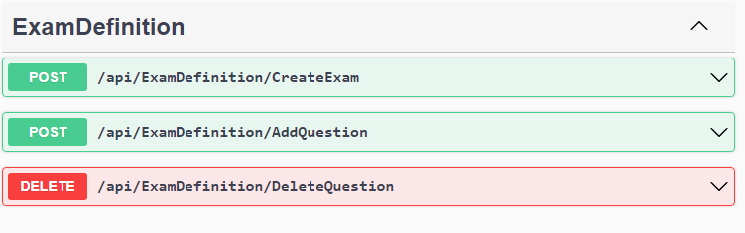
Api Design

Slide 22
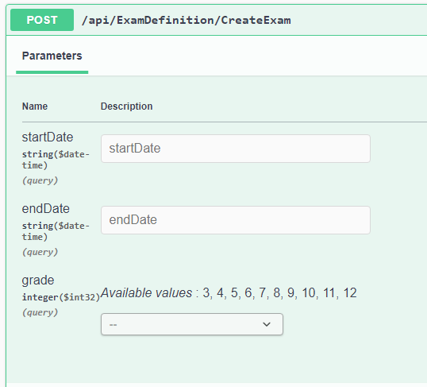
Api Design
Response
{
"isSuccess": true,
"result": {
"startTime": "2022-08-22T22:38:48.720Z",
"endTime": "2022-08-22T22:38:48.720Z",
"grade": 3
},
"displayMessage": "string",
"errorMessages": [
"string"
]
}

Slide 23
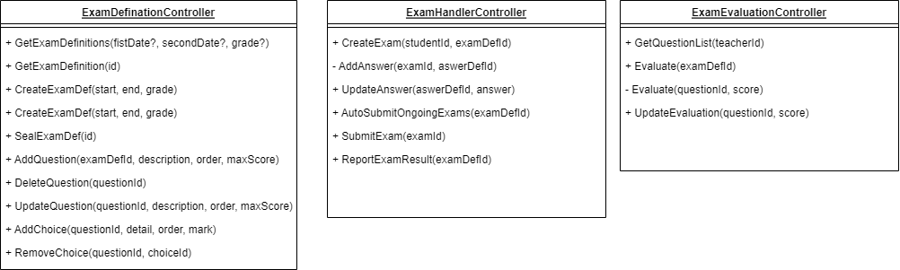
Class Diagram- Controllers
Controllers returns DTO classes to avoid exposing models
We can use automapper
Notes:
Create DTO classes because we don't want to expose the model directly
Auto mapper

Slide 24
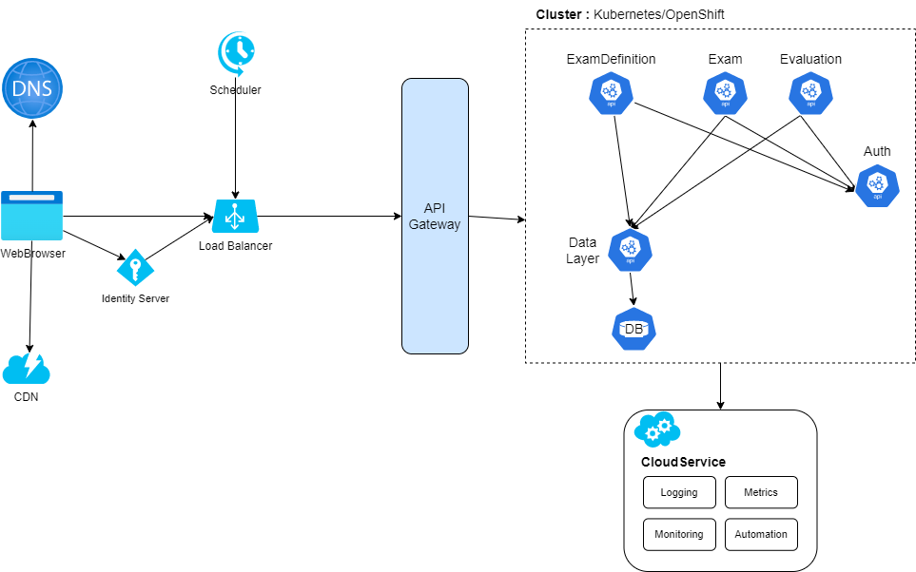
General Architecture
We should use cloud service like AWS, Azure or Google Cloud
We can use Kubernetes or Open Shift as Container Platform
Notes:
Create DTO classes because we don't want to expose the model directly
Auto mapper

Slide 25
Data Modelling
Entity Framework
Back of the envelope estimation
Multi Choice
1 byte x100 = 100 byte
Short Answers 200 byte x50 = 5000 byte
Assays
2000 byte x5 = 10.000 byte
Per exam
15.100 byte
Student per year
15.100 byte x10= 150.000 byte
Grand Total per year
150.000 byte x40.000 = 6.000.000.000 byte
= 6000 mb
= 6 gigabytes

Slide 26
Security
Vulnerability scanner tools can be integrated to deployment pipeline
Snyk Security Scan
Trivy
Cloud services offers integrated change approval systems

Slide 27
Regulatory Considerations
“A change approval processes involving three different government agencies is required for changes to the way student grades are kept to ensure security.”
We can use approvals, checks & gates for Azure Pipeline https://docs.microsoft.com/en-us/azure/devops/pipelines/process/approvals?view=azure-devops&tabs=check-pass

Slide 28
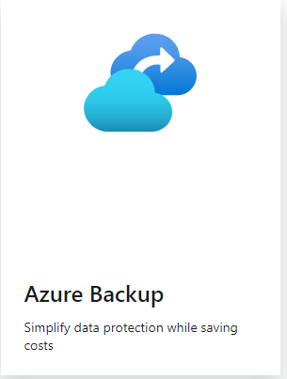
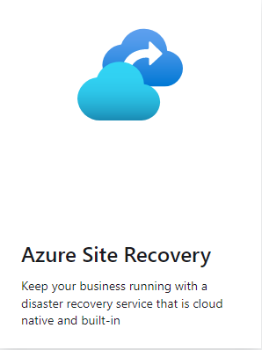
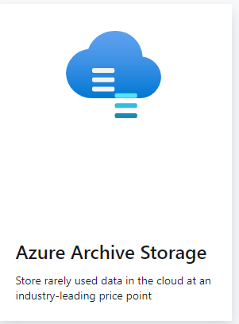
Disaster Recovery / Data Replication

Slide 29


